Slide 1
Safety in the Bee Yard
Carl J. Wenning, Advisor
ISU Beekeeping Club

Slide 2
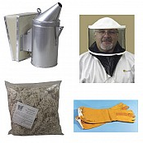
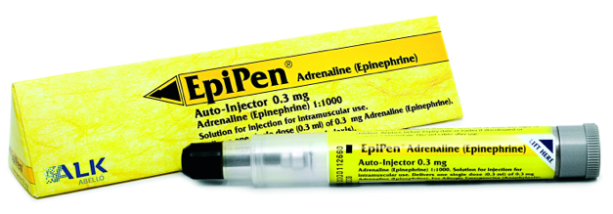
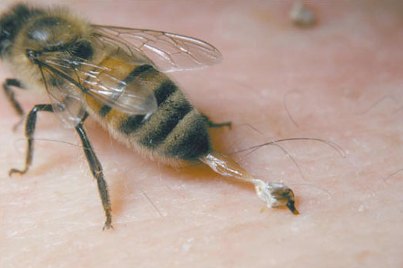
Bee Stings
It is better to prevent bee stings than attempt to treat them.
It is best to avoid bees if you are truly allergic.
Use protective coverings judiciously.
Use your smoker wisely.
Take appropriate action if stung.

Slide 3
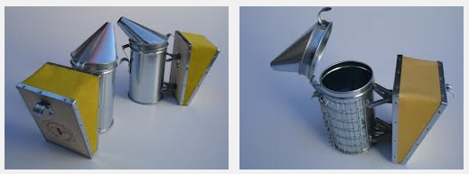
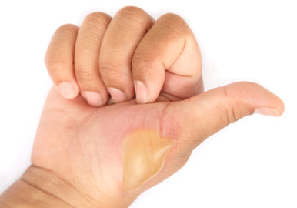
Burns
Burns most likely associated with smoker.
Better to avoid burns that to treat them.
Use smoker with protective screen to help avoid touching hot parts – use of gloves help.

Slide 4
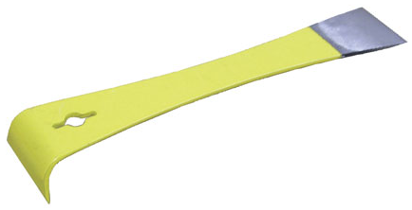
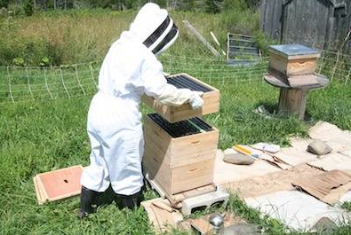
Cuts and Contusions
Cuts are most likely associated with inappropriate use of hive tools.
Contusions most closely associated with pinching or crushing of fingers when moving hive parts in an unsafe manner.

Slide 5
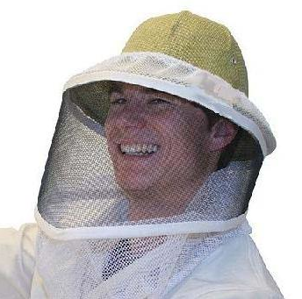
Eye Damage
Stings to the eye can and do occur.
Cataracts can result from excess exposure to UV rays from the sun.
Consider using a veiled and brimmed helmet to reduce exposure.

Slide 6
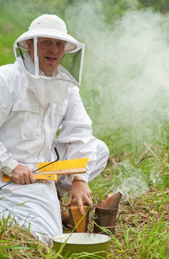
Fire
Grass fires can begin from careless lighting of the smoker.
They can also begin from careless disposal of ashes.
Catalytic converters from cars and trucks also initiate fires under dry conditions.

Slide 7
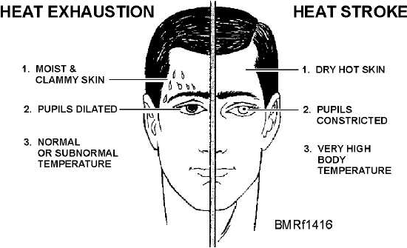
Heat-related Illnesses
Heat stroke and exhaustion can occur because of high temperatures, high humidity, and bee suites working in unison.

Slide 8
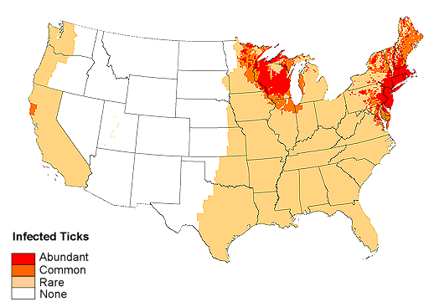
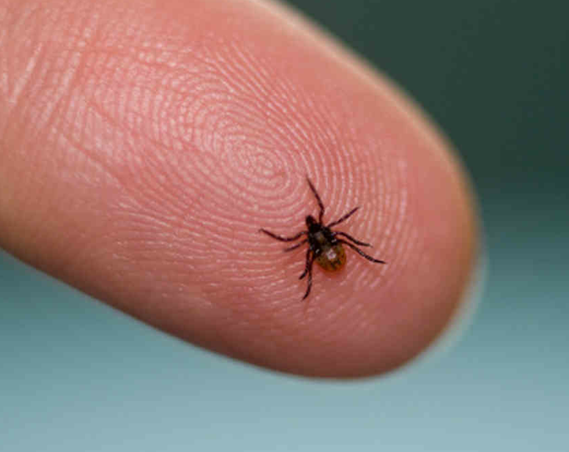
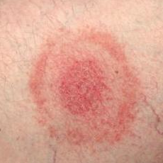
Lyme Disease
Passed on by infected deer ticks with very serious health consequences.

Slide 9
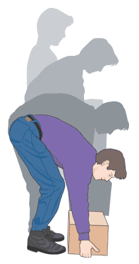
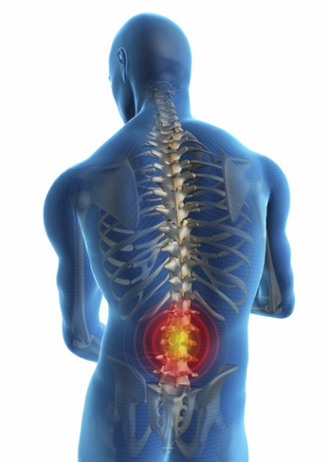
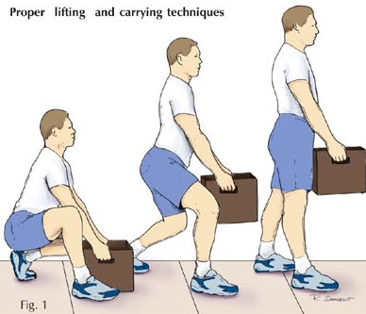
Muscle Strain
Mostly affects back due to improper lifting.
Use proper a lifting technique.

Slide 10
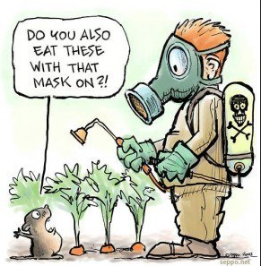
Pesticide Exposure
Exposure occurs either through direct contact with a pesticide or through honey itself.
Always follow label instructions; it is a civil crime when failing to do so.

Slide 11
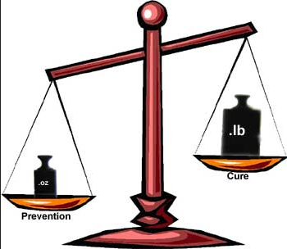
The Message…
Serious consequences – legal and medical – can occur for those who fail to carefully observe and follow safety procedures.
The best way to deal with these consequences is to prevent them from happening in the first place.

